Slide 1
Chapter 1
1-5 ~ 1-6

Slide 2
Algorithm
Definition: An algorithm is a finite set of instructions that, if followed, accomplishes a particular task. In addition, all algorithms must satisfy the following criteria:
  Input. Zero more quantities are externally supplied.
  Output. At least one quantity is produced.
  Definiteness. Each instruction is clear and unambiguous.
  Finiteness. If we trace out the instructions of an algorithm, then for all cases, the algorithm terminates after a finite number of steps.
  Effectiveness. Every instruction must be basic enough to be carried out, in principle, by a person using only pencil and paper. It is not enough that each operation be definite as in 3) it also must be feasible.

Slide 3
Selection Sort
Suppose we must devise a program that sorts a collection of n ≥ 1 integers.
From those integers that are currently unsorted, find the smallest and place it next in the sorted list.
Problem in the above statement
  Does not describe where and how the integers are initially sorted.
  Does not indicate where to place the result.

Slide 4
C++ Program for Selection Sort
void sort (int *a, const int n)
// sort the n integers a[0] to a[n-1] into non-decreasing order
{
for (int i = 0; i < n; i++)
{
int j = i;
// find smallest integer in a[i] to a[n-1]
for (int k = i + 1; k < n; k++)
if (a[k] < a[j]) j = k;
// interchange
int temp = a[i]; a[i] = a[j]; a[j] = temp;
}
}

Slide 5
Selection Sort (Cont.)
Theorem 1.1: sort(a, n) correctly sorts a set of n ≥ 1 integers; the result remains in a[0] … a[n-1] such that a[0] ≤ a[1] ≤ … ≤ a[n–1].

Slide 6
Binary Search
Assume that we have n ≥ 1 distinct integers that are already sorted and stored in the array a[0] … a[n-1]. Our task is to determine if the integer x is present and if so to return j such that x = a[j]; otherwise return -1. By making use of the fact that the set is sorted, we conceive the following efficient method:
Let left and right, respectively, denote the left and right ends of the list to be searched. Initially, left = 0 and right = n – 1. Let middle = (left + right) / 2 be the middle position in the list. If we compare a[middle] with x, we obtain one of the three results:
(1) x < a[middle]. In this case, if x is present, it must be in the positions between 0 and middle – 1. Therefore, we set right to middle – 1.
(2) x == a[middle]. In this case, we return middle.
(3) x > a[middle]. In this case, if x is present, it must be in the positions between middle+1 and n-1. So, we set left to middle+1.

Slide 7
C++ Program for Binary Search
int BinarySearch (int *a, const int x, const int n)
// Search the sorted array a[0], … , a[n-1] for x
{
for (int left = 0, right = n - 1; left <= right;)
{
int middle = (left + right) / 2;
switch (compare (x, a[middle])) {
case ‘>’: left = middle+1; break; // x > a[middle]
case ‘<‘: right = middle -1; break; // x < a[middle]
case ‘=‘: return middle; // x == a[middle]
} // end of switch
} // end of for
return -1;
} // end of BinarySearch

Slide 8
C++ Program for Binary Search
char compare (int x, int y)
{
if (x > y) return ‘>’;
else if ( x < y) return ‘<‘;
else return ‘=‘;
} // end of compare

Slide 9
Recursive Algorithms
Direct Recursive
  The functions may call themselves before they are done
Indirect Recursive
  They may call other functions that again invoke the calling function

Slide 10
E.g. Recursive binary search
int BinarySearch (int *a, const int x, const int left, const int right)
// Search the sorted array a[left], … , a[right] for x
{
if (left <= right;) {
int middle = (left + right) / 2;
switch (compare (x, a[middle])) {
case ‘>’: return BinarySearch(a, x, middle+1, right); // x > a[middle]
case ‘<‘: return BinarySearch(a, x, left, middle -1); // x < a[middle]
case ‘=‘: return middle; // x == a[middle]
} // end of switch
} // end of for
return -1; // not found
} // end of BinarySearch

Slide 11
Performance Analysis
Space Complexity: The space complexity of a program is the amount of memory it needs to run to completion.
Time Complexity: The time complexity of a program is the amount of computer time it needs to run to completion.

Slide 12
Space Complexity
A fixed part that is independent of the characteristics of the inputs and outputs. This part typically includes the instruction space, space for simple varialbes and fixed-size component variables, space for constants, etc.
A variable part that consists of the space needed by component variables whose size is dependent on the particular problem instance being solved, the space needed by referenced variables, and the recursion stack space.
The space requirement S(P) of any program P is written as S(P) = c +Sp where c is a constant

Slide 13
Time Complexity
The time, T(P), taken by a program P is the sum of the compile time and the run (or execution) time. The compile time does not depend on the instance characteristics. We focus on the run time of a program, denoted by tp (instance characteristics).

Slide 14
Time Complexity in C++
General statements in a C++ program
  Step count
  Comments 0
  Declarative statements 0
  Expressions and assignment statements 1
  Iteration statements N
  Switch statement N
  If-else statement N
  Function invocation 1 or N
  Memory management statements 1 or N
  Function statements 0
  Jump statements 1 or N

Slide 15
Time Complexity (Cont.)
Note that a step count does not necessarily reflect the complexity of the statement.
Step per execution (s/e): The s/e of a statement is the amount by which count changes as a result of the execution of that statement.

Slide 16
Matrix Addition Example
line void add (matrix a, matrix b, matrix c, int m, int n)
1 {
2 for (int i = 0; i < m; i++)
3 for (int j = 0; j < n; j++)
4 c[i][j] = a[i][j] + b[i][j];
5 }

Slide 17
Step Count of Matrix Addition Example
void add (matrix a, matrix b, matrix c, int m, int n)
{
for (int i = 0; i < m; i++)
{
count++; // for for i
for (int j = 0; j < n; j++)
{
count++; // for for j
c[i][j] = a[i][j] + b[i][j];
count++; // for assigment
}
count++; // for last time of for j
}
count++; // for last time of for i
}

Slide 18
Step Count of Matrix Addition Example (Simplified)
line void add (matrix a, matrix b, matrix c, int m, int n)
{
for (int i = 0; i < m; i++)
{
for (int j = 0; j < n; j++)
count += 2;
count+2;
}
count++;
}

Slide 19
Step Table of Matrix Addition Example
Line | s/e | Frequency | Total steps
1 | 0 | 1 | 0
2 | 1 | m+1 | m+1
3 | 1 | m(n+1) | mn+m
4 | 1 | mn | mn
5 | 0 | 1 | 0
 | Total number of steps |  | 2mn+2m+1

Slide 20
Fibonacci Numbers
The Fibonacci sequence of numbers starts as 0, 1, 1, 2, 3, 5, 8, 13, 21, 34, 55, …
Each new term is obtained by taking the sum of the two previous terms. If we call the first term of the sequence F₀ then F₀ = 0, F₁ = 1, and in general
F_{n} = F_{n-1} + F_{n-2} , n ≥ 2.

Slide 21
C++ Program of Fibonacci Numbers
1 void fibonacci (int n)
2 // compute the Fibonacci number F_{n}
3 {
4 if (n <= 1) cout << n << endl; // F₀ = 0, and F₁ = 1
5 else { // compute F_{n}
6 int fn; int fnm2 = 0; int fnm1 = 1;
7 for (int i = 2; i <= n; i++)
8 {
9 fn = fnm1 + fnm2;
10 fnm2 = fnm1;
11 fnm1 = fn;
12 } // end of for
13 cout << fn << endl;
14 } // end of else
15 } // end of fibonacci

Slide 22
Step Count of Fibonacci Program
Two cases:
  n = 0 or n = 1
    Line 4 regarded as two lines: 4(a) and 4(b), total step count in this case is 2
  n > 1
    Line 4(a), 6, and 13 are each executed once
    Line 7 gets executed n times.
    Lines 8 – 12 get executed n-1 times each.
    Line 6 has s/e of 2 and the remaining lines have an s/e of 1.
    Total steps for the case n > 1 is 4n + 1

Slide 23
Asymptotic Notation
Determining step counts help us to compare the time complexities of two programs and to predict the growth in run time as the instance characteristics change.
But determining exact step counts could be very difficult. Since the notion of a step count is itself inexact, it may be worth the effort to compute the exact step counts.
Definition [Big “oh”]: f(n) = O(g(n)) iff there exist positive constants c and n₀ such that f(n) ≤ cg(n) for all n, n ≥ n₀

Slide 24
Examples of Asymptotic Notation
3n + 2 = O(n)
  3n + 2 ≤ 4n for all n ≥ 3
100n + 6 = O(n)
  100n + 6 ≤ 101n for all n ≥ 10
10n² + 4n + 2 = O(n²)
  10n² + 4n + 2 ≤ 11n² for all n ≥ 5

Slide 25
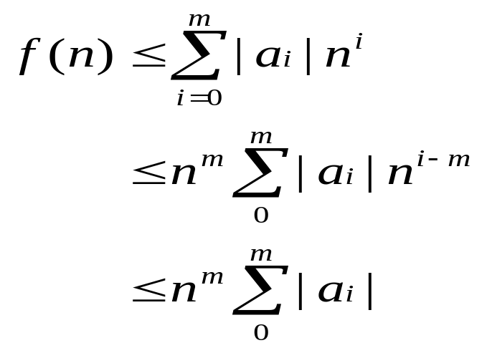
Asymptotic Notation (Cont.)
Theorem 1.2: If f(n) = a_{m}n^{m} + … + a₁n + a₀, then f(n) = O(n).
Proof:
for n ≥ 1
So, f(n) = O(n^{m})

Slide 26
Asymptotic Notation (Cont.)
Definition: [Omega] f(n) = Ω(g(n)) iff there exist positive constants c and n₀ such that f(n) ≥ cg(n) for all n, n ≥ n_{0.}
Example:
  3n + 2 = Ω(n)
  100n + 6 = Ω(n)
  10n² + 4n + 2 =Ω(n²)

Slide 27
Asymptotic Notation (Cont.)
Definition: f(n) = Θ(g(n)) iff there exist positive constants c₁, c₂, and n₀ such that c₁g(n) ≤ f(n) ≤ c₂g(n) for all n, n ≥ n₀.

Slide 28
Asymptotic Notation (Cont.)
Theorem 1.3: If f(n) = a_{m}n^{m} + … + a₁n + a₀ and a_{m} > 0, then f(n) = Ω(n).
Theorem 1.4: If f(n) = a_{m}n^{m} + … + a₁n + a₀ and a_{m} > 0, then f(n) = Θ(n).

Slide 29
Practical Complexities
If a program P has complexities Θ(n) and program Q has complexities Θ(n²), then, in general, we can assume program P is faster than Q for a sufficient large n.
However, caution needs to be used on the assertion of “sufficiently large”.

Slide 30
Function Values
log n | n | n log n | n² | n³ | 2^{n}
0 | 1 | 0 | 1 | 1 | 2
1 | 2 | 2 | 4 | 8 | 4
2 | 4 | 8 | 16 | 64 | 16
3 | 8 | 24 | 64 | 512 | 256
4 | 16 | 64 | 256 | 4096 | 65536
5 | 32 | 160 | 1024 | 32768 | 4294967296

Slide 31
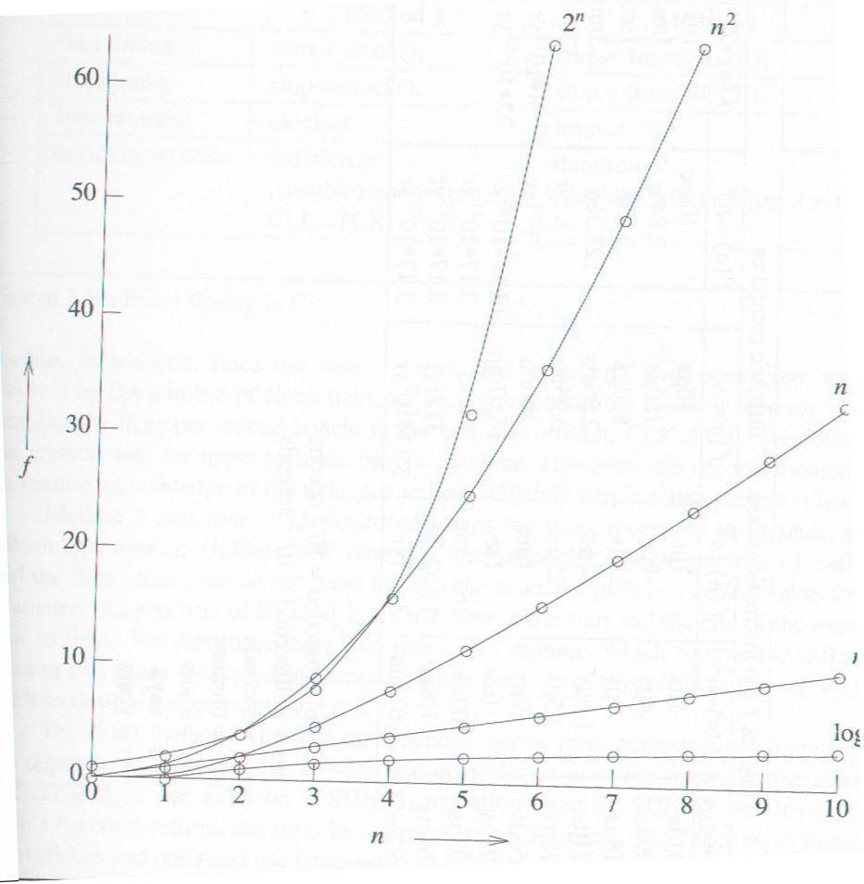
Plot of Function Values

Slide 32
Performance Measurement
Asymptotic analysis tells us the behavior only for “sufficiently large” values of n. For smaller values of n the run time may not follow the asymptotic curve.
The measured time plot may not lie exactly on the predicted curve due to the effects of lower terms.
To time a short event, it is necessary to repeat it several times and divide the total time for the event by the number of repetitions.
Clock precision is a factor

